Slide 1
‘Abstract Generator’ for Research Papers
-Vinay Patel (MT2019133)
-Jitesh Nemade (MT2019051)
-Harsh Padhya (MT2019044)
-Under the Guidance of
Prof G Srinivasaraghavan

Slide 2
Introduction
Automatic summarisation is the task of reducing a document to its main points.
There are two streams of summarisation approaches: extractive summarisation, which copies parts of a document (often whole sentences) to form a summary, and abstractive summarisation, which reads a document and then generates a summary from it, which can contain phrases not appearing in the document.
Here, we are concerned with summarising scientific publications. Since scientific publications are a technical domain with fairly regular and explicit language, we opt for the task of extractive summarisation
Large number of conference papers are accessible today and all of have some standard features: starting with a short abstract, introduction, related work, main contribution, conclusions/discussion etc. Scrape these to create a dataset for papers and their abstract. Train an ‘Abstract Generator’ for papers using the scraped data as annotated data for supervised learning.

Slide 3
Dataset Creation
We have downloaded around 120 research papers from arXiv Api which are in pdf format in domain of RNN.
Then we converted the pdf papers into text format using Textract package in python.
It works with scanned PDF files but quality of data extracted is unsatisfactory if scanned pages are blurred.
Sometimes it adds unnecessary spaces between a word’s characters
E.g A B STR ACT
Here images, figures are ignored.

Slide 4
Data Preprocessing
Once all papers are converted to text files we performed some preprocessing on text papers like converting to lowercase, removing special characters, removing stop words,removing sentences of very less length.
Then we removed references section of the papers as this section doesn’t contribute in abstract of paper.
Then we separated abstract from rest of the paper and stored in separate folder.
Here manual intervention is needed since many unnecessary spaces are added in topic heading so that it becomes difficult to identify particular section of paper programmatically.

Slide 5
Solution Outline
We have adopted two approaches to the problem in this project
Using unsupervised approach (Text Rank Algorithm)
This algorithm is similar to the Page Rank Algorithm.
Similarity between any two sentences is used as an equivalent to the web page transition probability.
The similarity scores are stored in a square matrix, similar to the matrix M used for PageRank.
Using supervised approach
In this approach we build a deep learning model which will predict the rouge score of for each sentence.
We trained the model on 100 papers and tested it on 20 papers.

Slide 6
Interpretation of Rouge score
ROUGE metrics are evaluation metrics for summarisation which correspond well to human judgement of good summaries.
In short and approximately:
ROUGE-n recall=40% means that 40% of the n-grams in the reference summary are also present in the generated summary.
ROUGE-n precision=40% means that 40% of the n-grams in the generated summary are also present in the reference summary.
ROUGE-n F1-score=40% is harmonic mean of precision and recall.

Slide 7
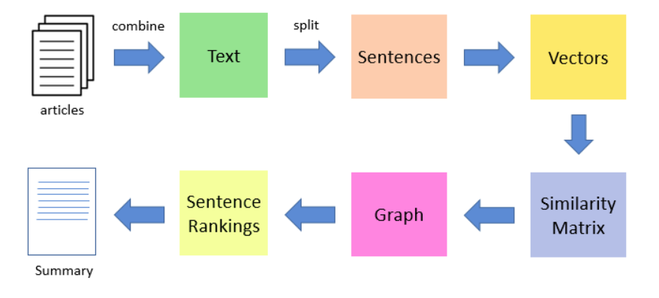
Flow of the TextRank algorithm

Slide 8
Flow of the TextRank algorithm
The first step would be to concatenate all the text contained in the articles
Then split the text into individual sentences
In the next step, we will find vector representation (GloVe word embeddings) for each and every sentence
Cosine similarities between sentence vectors are then calculated and stored in a matrix
The similarity matrix is then converted into a graph, with sentences as vertices and similarity scores as edges, for sentence rank calculation
Finally, a certain number of top-ranked sentences form the final summary

Slide 9
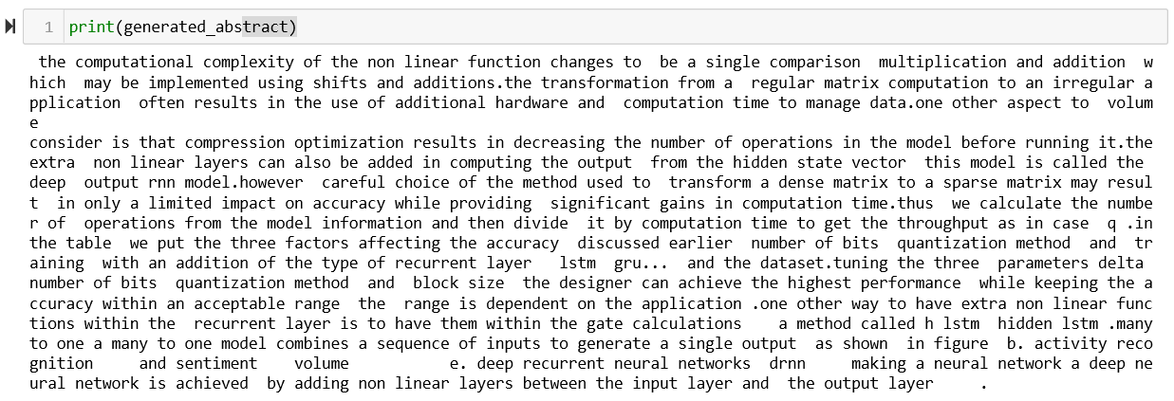
Example Output(Generated Abstract)

Slide 10
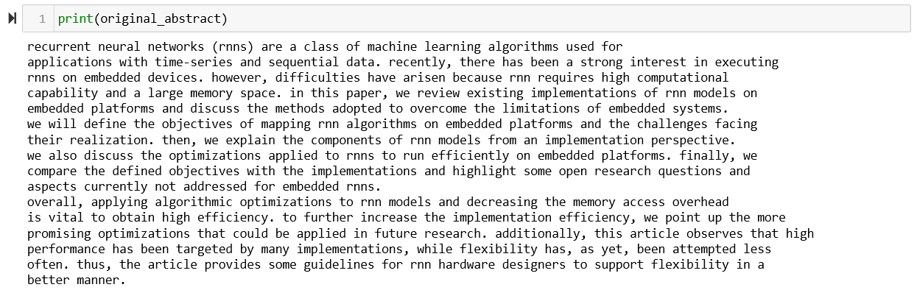
Ground Truth(Original Abstract)

Slide 11
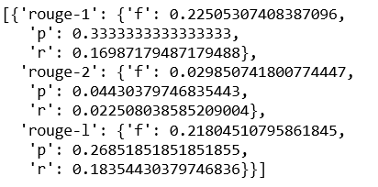
Observation
The abstracts generated using this approach shows Rouge-1 score of 0.20 to 0.30.
Here is the snippet of rouge score of above example

Slide 12
Using Supervised Approach
Method
In this approach we generated train data on sentences of 100 papers in domain of RNN.
And we found the rouge score(Rouge-1 f-1) of each sentence with the abstract of the paper.
Here we used Glove word embedding for vector representation of the each word and these embeddings are averaged to create the vector representation of a sentence.
Then we build a neural network model which take inputs the sentence embeddings and predicts the rouge score. This model is trained on all the sentences of these 100 papers.
In order to evaluate the model we tested it on a set of 20 papers. Here top 10 sentences which have high rouge score are selected and final score is calculated between original abstract and these selected sentences.

Slide 13
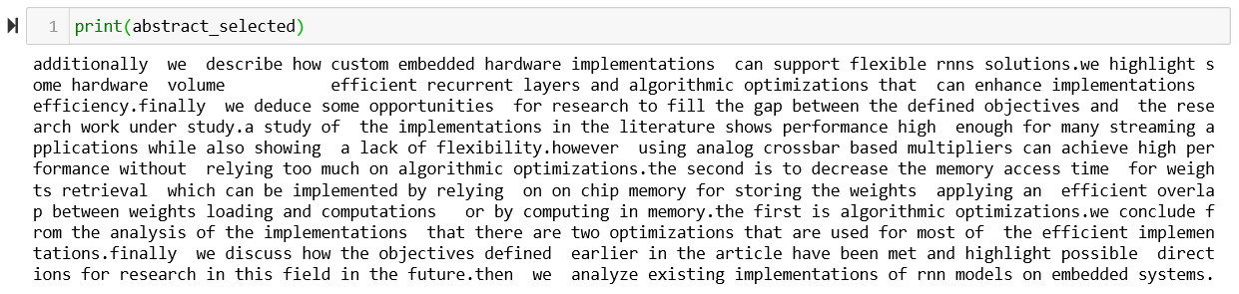
Example Output (Generated Abstract)

Slide 14
Ground Truth(Original Abstract)

Slide 15
Rouge Score of example paper
[{'rouge-1': {'f': 0.4465116229546783, 'p': 0.4067796610169492, 'r': 0.4948453608247423},
'rouge-2': {'f': 0.10280373336590558, 'p': 0.09361702127659574, 'r': 0.11398963730569948},
'rouge-l': {'f': 0.3560606011435377, 'p': 0.31543624161073824, 'r': 0.40869565217391307}}]

Slide 16
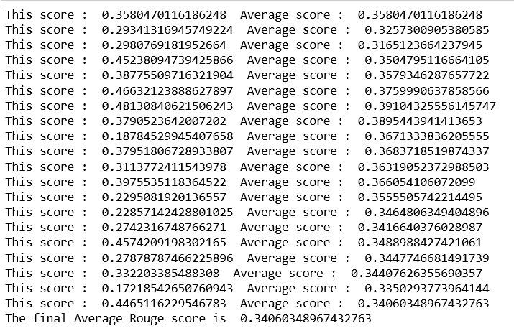
Using Supervised Approach
Results
We tested the model on 20 research papers and got average rouge score of 0.3406

Slide 17
References
[1] Ed Collins and Isabelle Augenstein and Sebastian Riedel , A Supervised Approach to Extractive Summarisation of Scientific Paper (https://arxiv.org/abs/1706.03946)
[2] Chirantana Mallick, Ajit Kumar Das, Madhurima Dutta, Asit Kumar Das and Apurba Sarkar, Graph-Based Text Summarization Using Modified TestRank. (https://doi.org/10.1007/978-981-13-0514-6_14)

Slide 18
Thank you!!

